Slide 1
Capstone of ZUHA AHMAD
Statistics & Modeling
Coding with Performance on Big Data
Communicating Results for Decision-Making
Venn Diagram of Data Science Skills

Slide 2
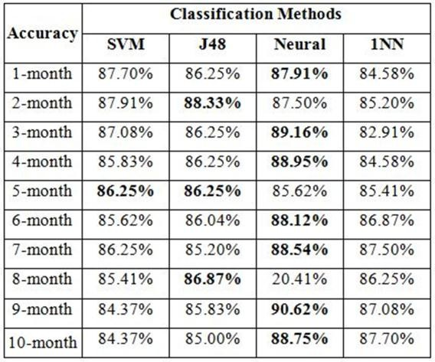
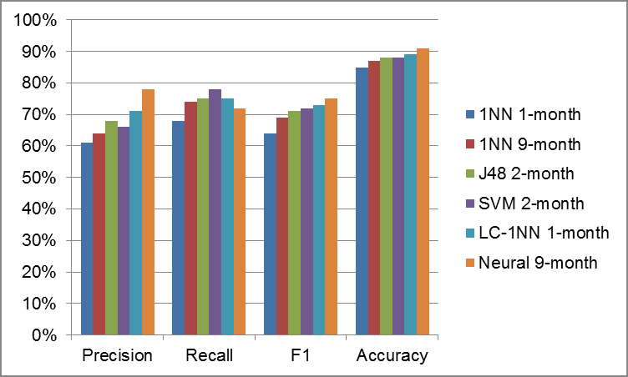
Contribution of Competitor’s Article
Best Overall Classifier Performance
Figure 7
Focus – Arrest, Commercial Burglary, Foreclosure, Motor Vehicle, Larceny, Residential Burglary, Street Robbery
Discuss approach to architecting dataset from original crime records
Perform an ensemble of data mining classification techniques to employ to perform crime forecasting
Propose the best forecasting to achieve the most stable outcomes
Figure 7.
Overall classification results.
Best performance of classifier using different training sets.
Yu, C. H., Ward, M. W., Morabito, M., & Ding, W. (2011, December). Crime forecasting using data mining techniques. In Data Mining Workshops (ICDMW), 2011 IEEE 11th International Conference on (pp. 779-786). IEEE.

Slide 3
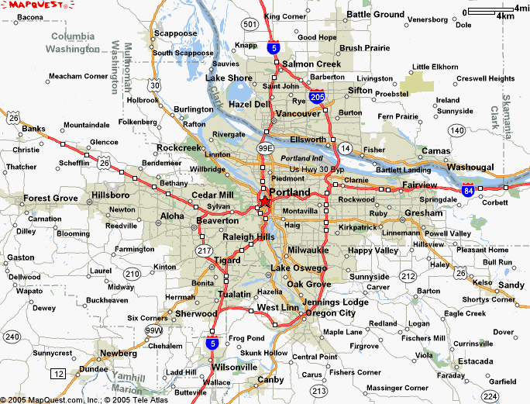
Description of Your Contribution
Generate crime forecasting in Portland, Oregon
Location (safe & unsafe areas)
Compare available crime forecasting methods
Improve place-based crime forecasting
Apply K-means clustering algorithm
Grouped the data for spatial ‘hotspot’
Create an application to visualize crime clusters in the city map

Slide 4
Data Source and Content
United States National Institute of Justice (USNIJ)
Provided by the Portland Police Bureau (PPB) for the period of March 1, 2012 through February 28, 2017. March 1, 2012 – February 28, 2017 (Updated) Variables in dataset included accident, burglary, cold stabbing, school disturbance(p), call disturbance(p), shooting(p), assault(p) * (p) = Priority

Slide 5
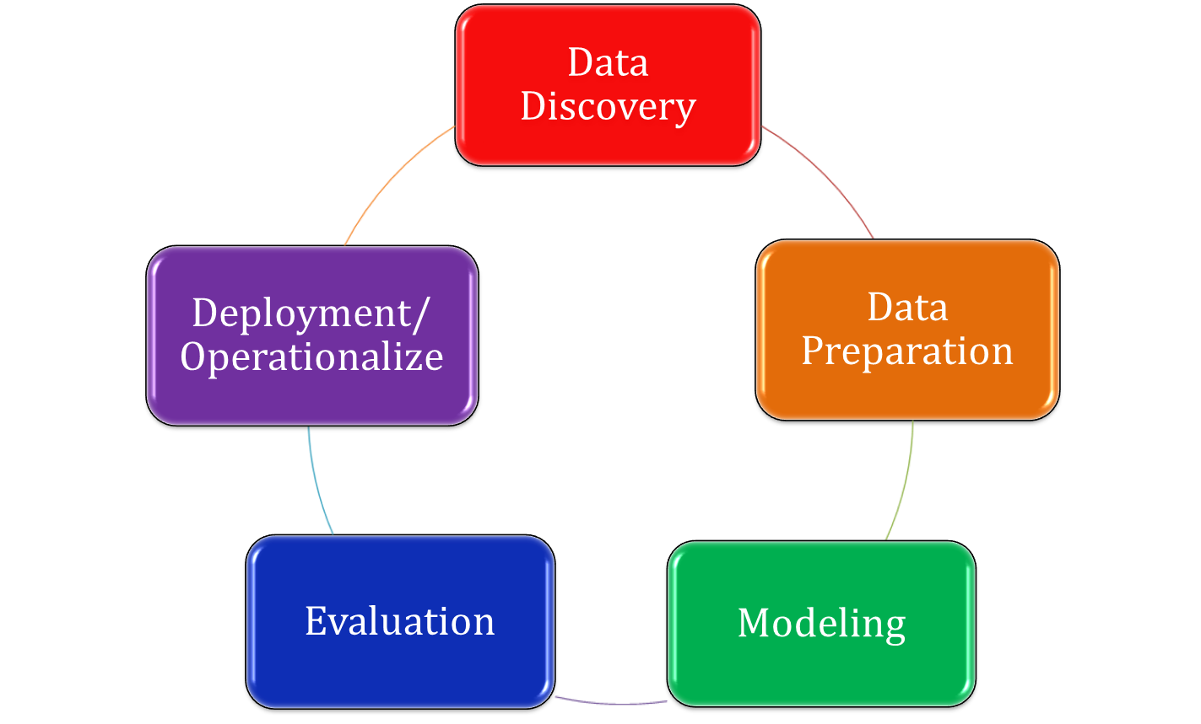
Your Method
United States National Institute of Justice (USNIJ)
R Shiny Application
Zeppelin Notebook
R Programming & Shiny Application
R Programming (RStudio)

Slide 6
Quantitative Results 1
MAP KEY & LEGEND
1 incident
Accidents (2012) | Accidents (2016)
1273 518 385 214 118 115 110 12 3 | 1692 1496 915 582 561 326 78 41 20 11 3
2-9 incidents
10-99 incidents
100+ incidents
- - - --- - Year 2012
Year 2016

Slide 7
Quantitative Results 1
MAP KEY & LEGEND
1 incident
Burglary (2012) | Burglary (2016)
2340 1577 1025 633 244 103 70 47 37 | 3308 2619 1839 1039 468 41 12 4 2
2-9 incidents
10-99 incidents
100+ incidents
- - - --- - Year 2012
Year 2016

Slide 8
Quantitative Results 1
MAP KEY & LEGEND
Shots Fired (2012) | Shots Fired (2016)
171 95 78 66 29 24 16 3 | 224 209 154 63 52 20 12 3
1 incident
2-9 incidents
10-99 incidents
100+ incidents
- - - --- - Year 2012
Year 2016

Slide 9
Quantitative Results 2
ACCIDENT

Slide 10
Quantitative Results 1
BURGLARY

Slide 11
Quantitative Results 2
SHOOTING

Slide 12
Discussion: Comparison With Your Competitor
Competitor’s Results
Your Results
3 Results – Leveraging Spatial Knowledge
Success of the simple 1NN classifier modified with location constraint.
Finding the most similar circumstance within the same neighborhood proved more effective than finding it within the entire city.
Naive Bayes classifier yields better results than Neural Networks
24-by-20 grid data - Success measures are consistently higher when using lower resolution data set
Due to each grid cell exhibiting a broader spatial knowledge
K-Means Clustering was easily interpretable
Advantage: Simple, yet robust
Successfully Isolated variables in accordance with the map
Accident 2012: Highest Incidents in a Cluster: 1,273; Lowest Incidents in a Cluster: 3
Accident 2016: Highest Incidents in a Cluster: 1,692; Lowest Incidents in a Cluster: 3
Burglary 2012: Highest Incidents in a Cluster: 2,340; Lowest Incidents in a Cluster: 37
Burglary 2016: Highest Incidents in a Cluster: 3,308; Lowest Incidents in a Cluster: 2
Shooting 2012: Highest Incidents in a Cluster: 171; Lowest Incidents in a Cluster: 3
Shooting 2016: Highest Incidents in a Cluster: 224; Lowest Incidents in a Cluster: 2

Slide 13
Performance on Big Data: Time Measurements
Operation | Application | Time Measurement
Load raw dataset in Spark | Zeppelin Notebook | 45 seconds
Load data | R | 1 minute
Aggregate data | R | 5 minutes
Loading server to map | R Shiny | 2 minutes

Slide 14
Conclusion
Identified crime clusters over a period of time
Crimes in 2016 overall had increased from 2012 for all three variables
Majority of crime activities occur near the rivers
For example: Lloyd district & pearl district is heavily impacted
Achieved results by updating data that is supplied into the application
Crimes in 2016 overall had increased from 2012
There are clusters that are moving up north towards Washington State, particularly in Vancouver.

Slide 15
Quiz for Your Classmates
What statistical method was used?
What programming tool was used?
What scientific contribution was made?
What idea could be useful for your project?

